Slide 1
Bill It
Project Title
A Bill Generator

Slide 2
Project By
Avais Ahmad
1300112037
Emran Husain
1300112044
Guided By
Associate Professor :
Saima Rehman
Lab instructor :
Deshnidhi Yadav

Slide 3

Logo

Slide 4
Introduction
This Project will be used by a shop for billing purpose.
It will provide all the features for Product billing in Shop.
It will be installed in the systems at billing counters.

Slide 5
The shops database will be connected to this Software.
It will Update the database as per shopping by customer.
The product EAN or Product ID will be used as the primary key to access the database.

Slide 6
Features
Show Product Price.
Customer information such as name and address are saved.
Show a table of items purchased by customer.

Slide 7
We just have to give EAN or product ID as the input and it will automatically detects the product and its details.
Automatically calculate discounts.
Automatically calculates Tax.
Updates database and invoke print screen on pressing print button.

Slide 8
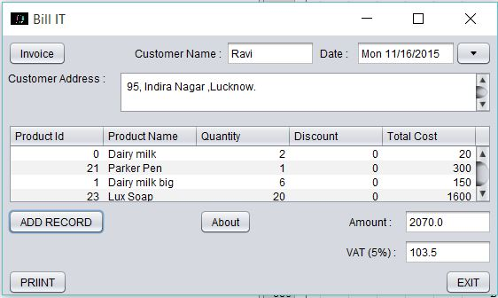
Screenshot

Slide 10
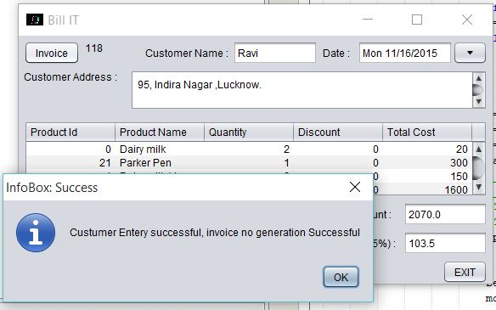

Slide 11
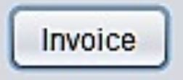
Description
Button Invoice
It Uses JButton.
It generates Unique invoice number in a label in front of it.
It also update invoice table in database.

Slide 12





Customer Name , Customer Address , amount ,vat and date are JLabels indicating the use of their respective textboxes.

Slide 13


Enter Name
It is a JTextFeild is Used to enter name of customer.
Date
It use JDatePicker to enter the date on which invoice is generated.

Slide 14
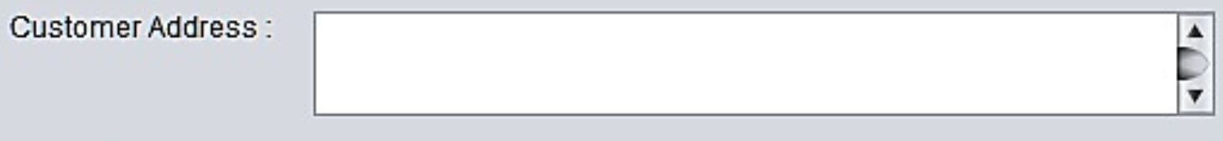
Custumer Address
It use JTextArea to enter address of Customer.

Slide 15
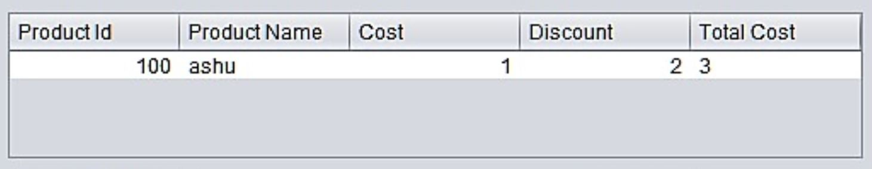
Tabel
It uses JTable.
It displays items purchased by customer.

Slide 16


It Uses JTextField.
It automatically displays vat calculated and total Amount calculated.

Slide 17

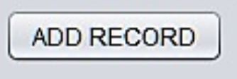
Print Button
It uses JButton.
It triggers default printer to print bill.
Add Record Button
It uses JButton .
It is used to take EAN as input.
It adds item purchased by customer to the table.

Slide 18

Exit Button
It use JButton.
It is used to exit from bill it program

Slide 19
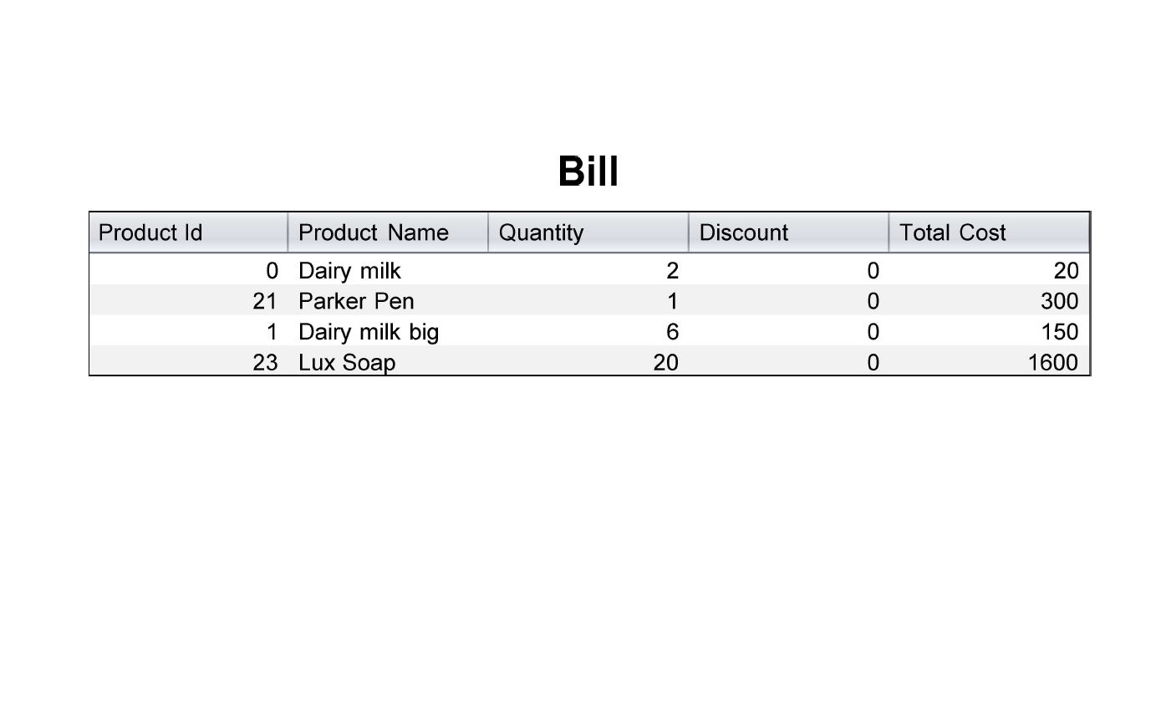
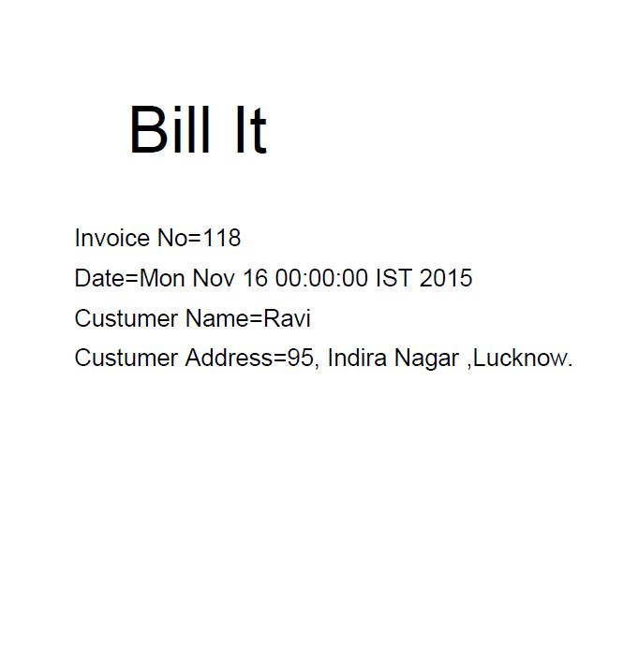
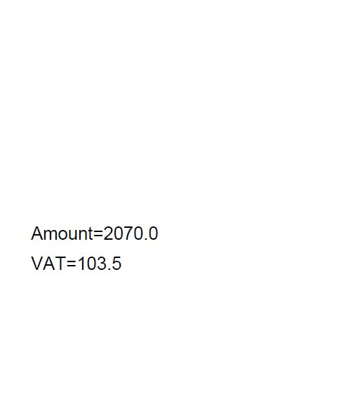
Print Pages (Output)

